Slide 1
Antimicrobials
Pharmacology

Slide 2
Basic Terminology
An antimicrobial is a chemical substance that has the capacity, in diluted solutions, to kill (biocidal activity) or inhibit the growth (biostatic activity) of microbes
Antimicrobials can be classified as:
  Antibiotics
  Antifungals
  Antivirals
  Antiprotozoals
  Antiparasitics

Slide 3
Pathogenic Microorganisms
Cause a wide variety of infections and illness in different organs or body systems
May be classified as local or systemic
  A localized infection may involve skin or an internal organ and may progress into a systemic infection
  A systemic infection involves the whole animal and is more serious than a local infection

Slide 4
Antimicrobials
The goal of antimicrobial treatment is to render the microbe helpless (either by killing them or inhibiting their replication) and not to hurt the animal being treated
Antibiotic treatment is accomplished by making sure that the infecting bacteria are susceptible to the antibiotic, that the antibiotic reaches the infection site and that the animal can tolerate the drug

Slide 5
Agar Diffusion Test
A.k.a. Kirby-Bauer antibiotic sensitivity testing
Used to determine if a particular antibiotic is effective against a particular bacterium.
Antibiotic-impregnated disks placed onto agar plates containing bacteria being tested.
After incubation at proper temperature for the proper time, zones of inhibition (clear zones) are measured and compared to a standardized chart to determine R.
  R = resistant (antibiotic does not work); I = intermediate (antibiotic may work); S = sensitive (antibiotic will work)

Slide 6
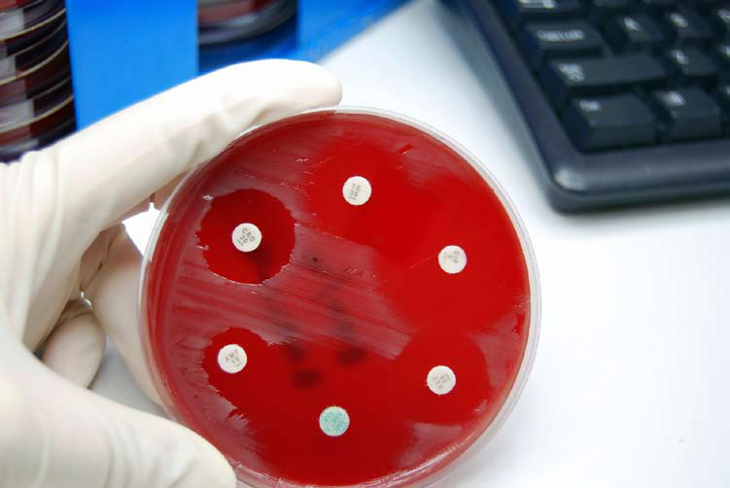

Slide 7
Antibiotics
Antibiotics work only on bacteria and are described by their spectrum of action (range of bacteria for which the agent is effective)
  Narrow-spectrum antibiotics work only on either gram-positive or gram-negative bacteria (not both)
  Broad-spectrum antibiotics work on both gram-positive and gram-negative bacteria (but not necessarily all)
Antibiotics can be classified as bactericidal or bacteriostatic
  Bactericidals kill the bacteria
  Bacteriostatics inhibit the growth or replication of bacteria

Slide 8
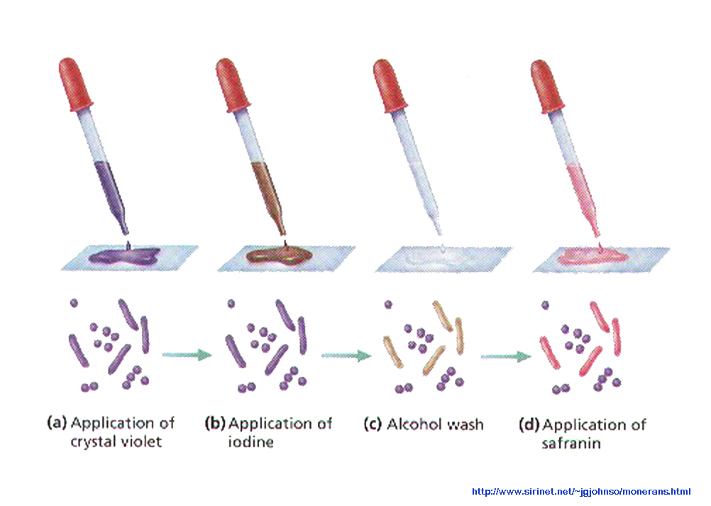
Gram stain Procedure

Slide 9
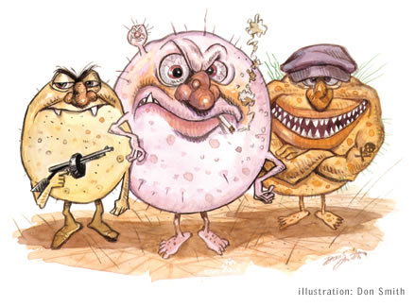
How Do Antibiotics Work?
Antibiotics work by a variety of mechanisms:
  Inhibition of cell wall synthesis
  Damage to the cell membrane
  Inhibition of protein synthesis
  Interference with metabolism
  Impairment of nucleic acids

Slide 10
Considerations when using antibiotics
Antibiotic resistance
  Means that the bacteria survive and continue to multiply after administration of the antibiotic
  Occurs when bacteria change in some way that reduces or eliminates the effectiveness of the agent used to cure or prevent the infection
  Can develop through bacterial mutation, bacteria acquiring genes that code for resistance, or other means

Slide 11
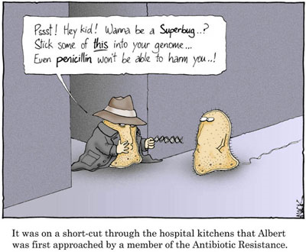

Slide 12
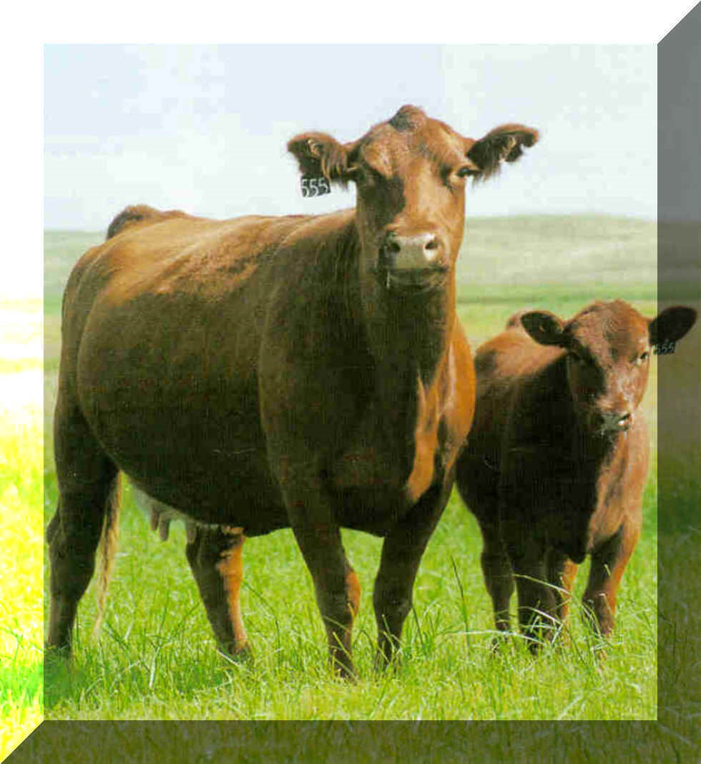
Considerations when using antibiotics
An antibiotic residue is the presence of a chemical or its metabolites in animal tissue or food products
  Antibiotic residues can cause allergic reactions in people or can produce resistant bacteria that can be transferred to people who consume these products
  Withdrawal times for antibiotics are aimed at eliminating antibiotic residues in food-producing animals

Slide 13
Considerations when using antibiotics
The FDA approves all drugs marketed for use in animals in the United States
The FDA also establishes tolerances for drug residues to insure food safety
The FDA also establishes withdrawal times and withholding periods
  Times after drug treatment when milk and eggs are not to be used for food, and also when animals are not to be slaughtered for their meat

Slide 14
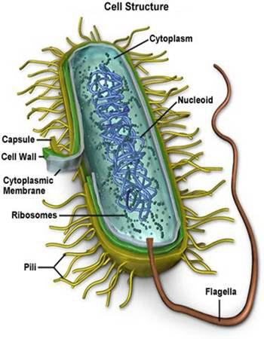
Classes of Antibiotics
Cell wall agents
Protein synthesis agents
Antimetabolites
Nucleic acid agents
Miscellaneous agents

Slide 15
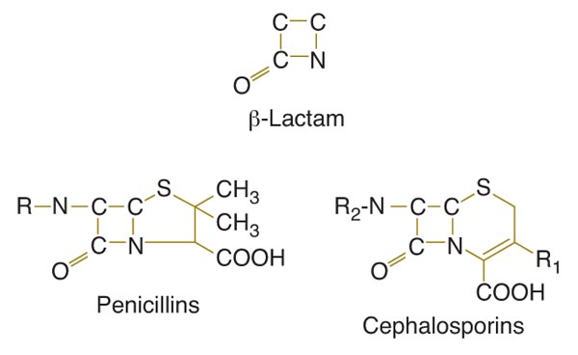
Cell Wall Agents
Penicillins
  Have beta-lactam structure that interferes with bacterial cell wall synthesis
  Identified by the –cillin ending in the drug name
  Spectrum of activity depends on the type of penicillin

Slide 16
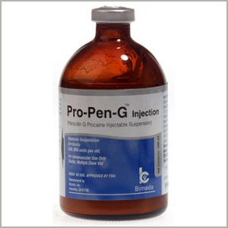
Cell Wall Agents
Penicillins (cont.)
  Penicillin G and V are narrow-spectrum
  gram-positive antibiotics
    Penicillin G is given parenterally
      Only sodium or potassium salt of Pen-G can be admin. IV
    Penicillin V is given orally
      Give PCN on empty stomach (except amoxicillin)
  Broader-spectrum penicillins are semi-synthetic
    Examples include amoxicillin, ampicillin, carbenicillin, ticarcillin, and methicillin

Slide 17
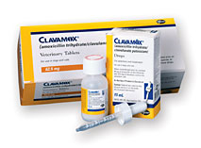
Cell Wall Agents
Penicillins (cont.)
  Beta-lactamase resistant penicillins are more resistant to beta-lactamase (an enzyme produced by some bacteria that destroys the beta-lactam structure of penicillin)
    Examples include methicillin, oxacillin, dicloxacillin, cloxacillin, and floxacillin
  Potentiated penicillins are chemically combined with another drug to enhance the effects of both
    An example is a drug containing amoxicillin and clavulanic acid (which binds to beta-lactamase to prevent the beta-lactam ring from being destroyed)

Slide 18
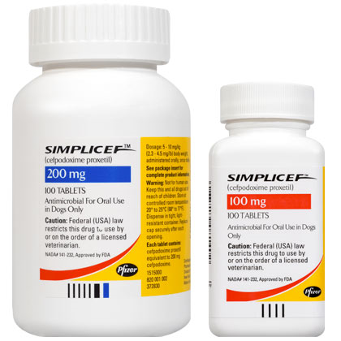
Cell Wall Agents
Cephalosporins
  Are semi-synthetic, broad-spectrum antibiotics that are structurally related to the penicillins
    Have the beta-lactam ring
    Can be identified by the ceph- or cef- prefix in the drug name
  Are classified into four generations
    In general, as the number of the generation increases, the spectrum of activity broadens (but becomes less effective against gram-positive bacteria)

Slide 19
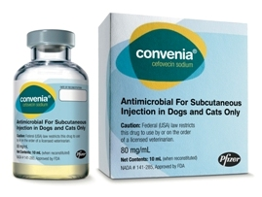
Convenia® (cefovecin sodium)
  First antibiotic that provides an assured course of treatment by providing up to 14 days of treatment in a single injection, eliminating missed doses associated with daily oral antibiotic administration
  Labeled specifically for secondary superficial pyoderma, abscesses, and wounds (S. intermedius, S. canis ) in dogs and abscesses and wounds (P. multocida) in cats.
  Must be reconstituted, refrigerated, and used within 28 days of reconstitution
  Second dose may be necessary in 14 days.

Slide 20
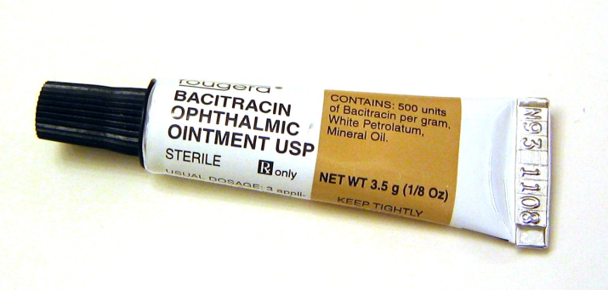
Cell Wall Agents
Bacitracin
  Disrupts the bacterial cell wall and is effective against gram-positive bacteria
  Used topically (skin, mucous membranes, eyes) and as a feed additive
  Toxic to kidneys
Vancomycin
  Bacteriocidal; effective against many gram-positive bacteria; used for resistant infections
  Useful in treatment of Staphylococcus aureus

Slide 21
Cell Membrane Agents
Polymyxin B
  Works by attacking the cell membrane of bacteria (remember that animal cells have cell membranes too)
  Is a narrow-spectrum, gram-positive antibiotic
    Not absorbed when taken orally or applied topically
    Used as an ointment or wet dressing
  Often combined with neomycin and bacitracin = triple ABX ointment

Slide 22
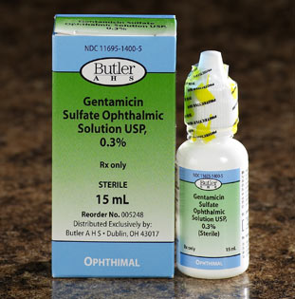
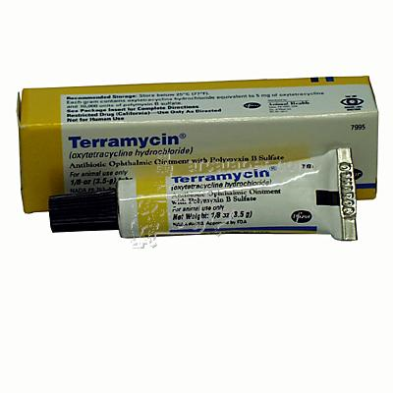
Protein Synthesis Agents
Aminoglycosides
  Interfere with the production of protein in bacterial cells
  Are a specialized group of antibiotics with a broad spectrum of activity, used for gram-negative bacteria
  Are not absorbed well from the GI tract, so are given parenterally
  May be recognized by –micin or –mycin ending in drug name (but are not the only group to use these suffixes)
  Side effects are nephrotoxicity and ototoxicity
  Examples include gentamicin, neomycin, amikacin, tobramycin, and dihydrostreptomycin
  NOT approved for use in food-producing animals.

Slide 23
Protein Synthesis Agents
Tetracyclines
  Are a group of bacteriostatic antibiotics with a broad spectrum of activity, including rickettsial agents
    Treats Lyme disease, Ehrlichia, Hemobartonella, others…
  Can bind to calcium (affecting muscle contraction) and be deposited in growing bones and teeth, or bind components of antacids and other mineral-containing compounds
  Are recognized by –cycline ending in drug name
  Examples include tetracycline, oxytetracycline, chlortetracycline, doxycycline, and minocycline
  Oral and parenteral forms

Slide 24
Protein Synthesis Agents
Chloramphenicol
  Is a broad-spectrum antibiotic that penetrates tissues and fluids well (including the eyes and CNS)
  Has toxic side effects (bone marrow depression) that extremely limit use
  Use caution when handling this product
  Chloramphenicol is the only drug in this category
  Also available in ophthalmic solution
  Used for RMSF (among other conditions)
  Banned from use in food-producing animals.
  Not considered a first-line drug

Slide 25
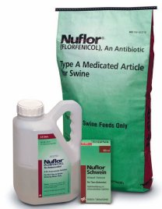
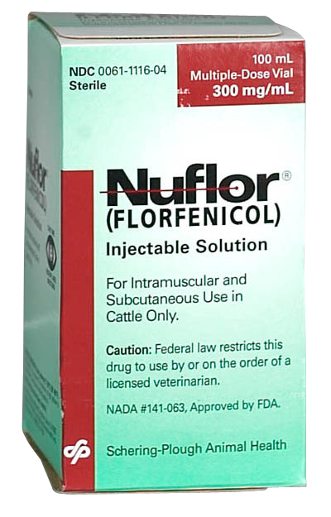
Protein Synthesis Agents
Florfenicol (Nuflor®)
  Is a synthetic, broad-spectrum antibiotic
  Injectable solution
  Used to treat bovine respiratory disease and foot rot.
  Side effects include local tissue reaction (possible loss of tissue at slaughter), inappetence, decreased water consumption, and diarrhea
  Florfenicol is the only drug in this category

Slide 26
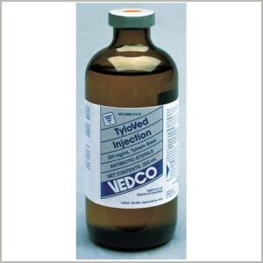
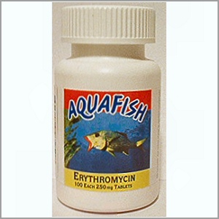
Protein Synthesis Agents
Macrolides
  Interfere with the production of protein in bacterial cells
  Are broad-spectrum antibiotics that have a large molecular structure
  Used to treat penicillin-resistant infections or in animals that have allergic reactions to penicillins
  May cause stomach upset in animals
    Erythromycin (oral or ointment)
    Tylosin (used mainly in livestock - can cause fatal diarrhea in horses)
    Tilmicosin (used to treat bovine respiratory disease – single injection)

Slide 27
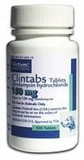
Protein Synthesis Agents
Lincosamides
  Interfere with the production of protein in bacterial cells
  Are narrow-spectrum, gram-positive antibiotics
  Side effects include GI problems
    Veterinarians typically use erythromycin instead.
  Examples include clindamycin, pirlimycin, and lincosamide

Slide 28
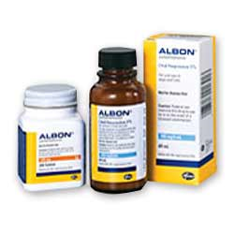
Antimetabolites
Sulfonamides
  Are broad-spectrum antibiotics that inhibit the synthesis of folic acid (needed for the growth of many bacteria)
  Some are designed to stay in the GI tract (enteric forms); some are absorbed by the GI tract and penetrate tissues (systemic forms)
  Side effects include crystalluria, KCS (dry eye), and skin rashes
  Precipitate in kidneys of animals that are dehydrated or have acidic urine; Adequate water intake = very important!
  Bactericidal when potentiated with trimethoprim or ormetoprim
  Examples include sulfadiazine/trimethoprim, sulfadimethoxine, and sulfadimethoxine/ormetoprim

Slide 29
Miscellaneous Agents
Nitrofurans
  Are broad-spectrum antibiotics that include furazolidone, nitrofurazone, and nitrofurantoin
  Used to treat wounds (topically) and urinary tract infections
  Filtered unchanged through kidneys
  Carcinogenic residues in animal tissues
Nitroimiazoles
  Have antibacterial and antiprotozoal activity; work by disrupting DNA and nucleic acid synthesis
  An example is metronidazole, which is considered by some the drug of choice for canine diarrhea

Slide 30
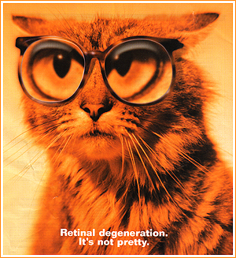
Nucleic Acid Agents
Fluoroquinolones
  Are antibiotics with fluorine bound to the quinolone base, which increases the drug’s potency, spectrum of activity, and absorption
  Are broad-spectrum antibiotics (gram + and gram -)
  Can be recognized by –floxacin ending in drug name
  Side effects include development of bubble-like cartilage lesions in growing dogs, and crystalluria
  Quinolone-induced blindness in cats.
  Indiscriminate use may result in bacterial resistance.
  Examples include enrofloxacin, ciprofloxacin, orbifloxacin, difloxacin, marbofloxacin, and sarafloxacin

Slide 31
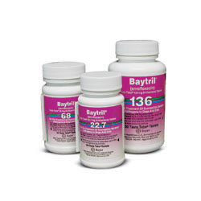
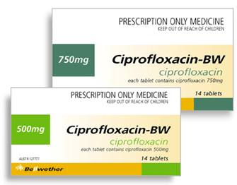
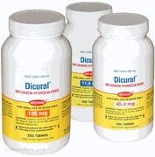
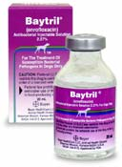
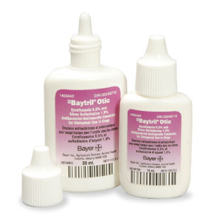
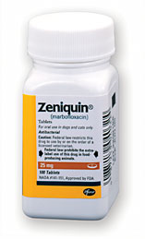
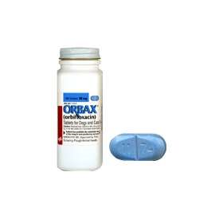

Slide 32
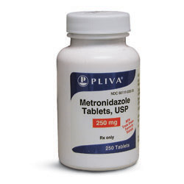
Metronidazole (Flagyl®) is drug of choice for canine diarrhea
  Used to treat Giardia and Trichomonas infections
  Also used for amoebiasis and anaerobic bacteria
  Oral or intravascular administration
  No approved veterinary form of metronidazole (used off-label)
  Do not use in pregnant animals
  Can cause neurologic signs (especially when given IV)

Slide 33
Miscellaneous Agents
Rifampin
  Disrupts RNA synthesis
  Is broad-spectrum; used in conjunction with other antibiotics (usually erythromycin)
  May impart a reddish color to urine, tears, sweat, and saliva.
Refer to Table 14-2 in your textbook for a review of antibiotics used in veterinary practice

Slide 34
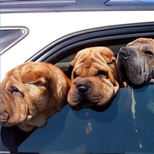
Antifungal Agents
Antifungals are chemicals used to treat diseases caused by fungi (mold or yeast)
Some fungal diseases are superficial (ringworm); others are systemic (blastomycosis)
Diagnosed by fungal media or serologic tests
Fungal infections are difficult to treat, and it takes a long course of drug treatment to resolve these infections.

Slide 35
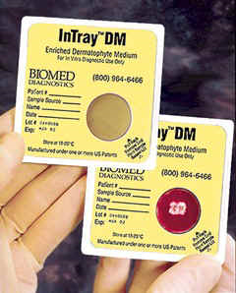
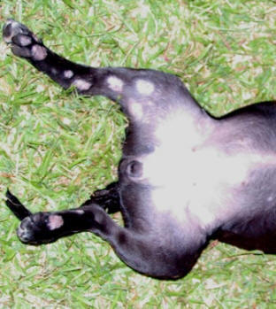
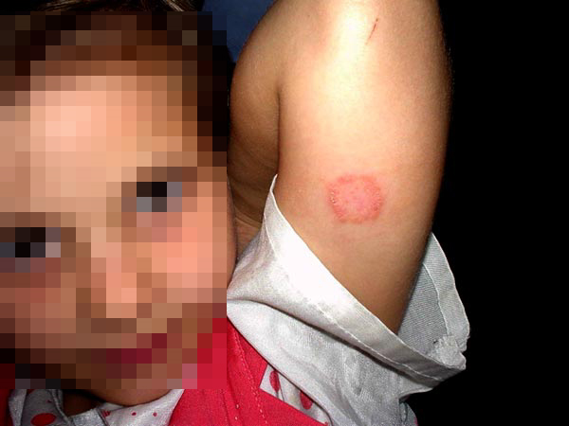
Ringworm

Slide 36
Categories of antifungals
  Polyene antifungal agents
  Imidazole antifungal agents
  Antimetabolic antifungal agents
  Superficial antifungal agents

Slide 37
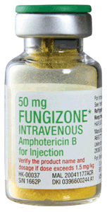
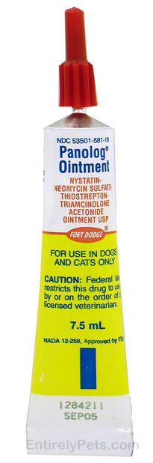
Polyene antifungals
  Work by binding to the fungal cell membrane
  Examples:
    Nystatin (Panalog®)
      frequently prescribed for proliferation of Candida albicans in the GI tract; a common result of antitiotic therapy
      Topical, oral, or IV
    Amphotericin B (Fungizone®)
      used IV for systemic mycoses
      extremely nephrotoxic, is light sensitive, and is usually given through a filter system because it can precipitate out of solution
      Also found in creams, lotions,and ointments

Slide 38
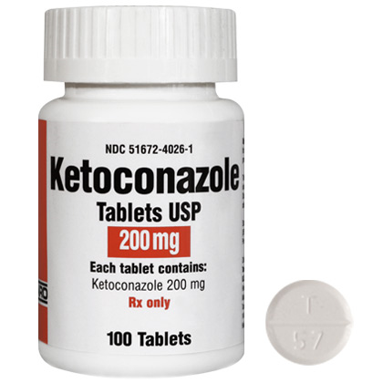
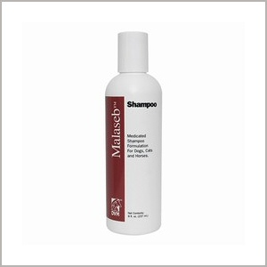
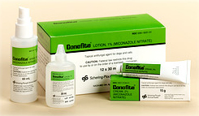
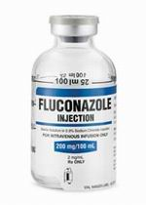
Imidazole antifungals
  Work by causing leakage of the fungal cell membrane
  Examples:
    Ketoconazole
      Oral and topical only
    Miconazole (Monistat®, Conofite®)
      Parenteral and topical forms only
    Itraconazole
      Oral
      Fewer side effects than Ketoconazole and Miconazole
    Fluconazole (Diflucan®)
      Oral or IV
      Especially useful in treating CNS infections
      Side effects = vomiting and diarrhea

Slide 39
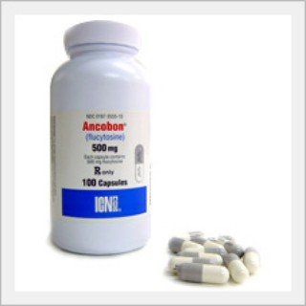
Antimetabolic antifungals
  Work by interfering with the metabolism of RNA and proteins
  An example is flucytosine
    usually used in combination with other antifungals
    Well absorbed by the GI tract
    Main side effect = bone marrow abnormalities

Slide 40
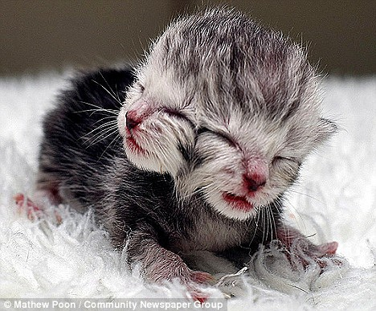

Superficial antifungals
  Work by disrupting fungal cell division
  An example is griseofulvin, an oral medication used to treat dermatophyte (ringworm)infections
  Administer with a fatty meal
  Ultramicrosize better absorbed than microsize formulation
  Gastrointestinal and teratogenic side effects; do not administer to pregnant or breeding animals

Slide 41
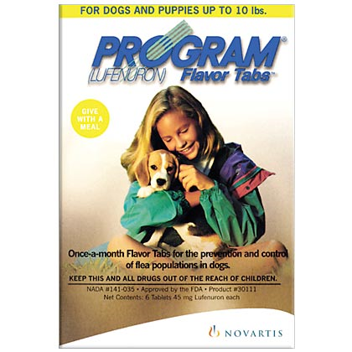
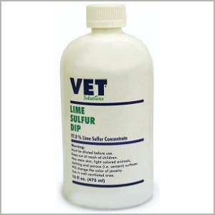
Antifungal Agents
Other antifungals
  Lufenuron is used to treat ringworm in cats
  Lyme sulfur is used topically to treat ringworm
Refer to Table 14-3 in your textbook for a review of antifungal agents

Slide 42
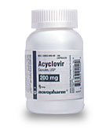
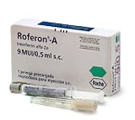
Antiviral Agents
Viruses are intracellular invaders that alter the host cell’s metabolic pathways
Antiviral drugs act by preventing viral penetration of the host cell or by inhibiting the virus’s production of RNA or DNA
Antiviral drugs used in veterinary practice are:
  Acyclovir (Zovirax®) interferes with the virus’s synthesis of DNA
    used to treat ocular feline herpes virus infections
    Tablets, suspension, injectable
  Interferons protect host cells from a number of different viruses
    Roferon-A® - an interferon inducer
    used to treat ocular feline herpes virus infection and FeLV
    Stimulates noninfected cells to produce antiviral proteins

Slide 43
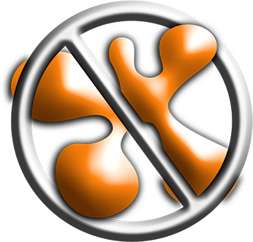
Controlling Growth of Microorganisms
Sterilization is the removal or destruction of all microbes
  achieved by steam under pressure, incineration, or ethylene oxide gas
Asepsis
  An environment or procedure that is free of contamination by pathogens
Disinfection = using physical or chemical agents to reduce the number of pathogens on inanimate objects

Slide 44
Disinfectants vs Antiseptics
Disinfectants kill or inhibit the growth of microorganisms on inanimate objects
Antiseptics kill or inhibit the growth of microorganisms on animate objects
Ideal agents should:
  Be easy to apply
  Not damage or stain
  Be nonirritating
  Have the broadest possible spectrum of activity
  Be affordable

Slide 45
Things to keep in mind when choosing/using products…
Keep in mind the surface it will be applied to
Keep in mind the range of organisms you want to eliminate
Products may be less effective in the presence of organic waste (must be applied to a thoroughly clean surface)
Read the package insert for dilution recommendations and special use instructions
  Always start with the quantity of water and add the chemical concentrate to avoid splashing chemicals into your eyes.
Contact time is critical to the efficacy of the product
Keep MSDS on all products

Slide 46
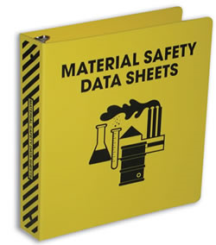
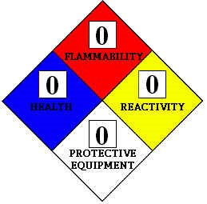
Material Safety Data Sheets
Always request and keep MSDS
Filing of MSDS and container labeling are important components of each facility’s hazard communication plan, which is required by OSHA
Hazard Communication Standard was enacted in 1988 to educate and protect employees who work with potentially hazardous material

Slide 47
Hazard Communication Plan
Should include:
  A written plan that serves as a primary resource for the entire staff
    Name of person responsible for keeping MSDS current
    Location of where MSDS kept, how obtained
    Procedures for labeling materials
    Outline emergency and clean-up procedures
  An inventory of hazardous materials on the premises
  Current MSDS for hazardous materials
  Proper labeling of all materials in the facility
  Employee training for every employee working with these materials

Slide 48
Must be on all MSDSs:
Product name and chemical identification
Name, address, and telephone number of the manufacturer
List of all hazardous ingredients
Physical data for the product
Fire and explosion information
Information on potential chemical reactions when the product is mixed with other materials
Outline of emergency and cleanup procedures
Personal protective equipment required when handling the material
A description of any special precautions necessary when using the material

Slide 49
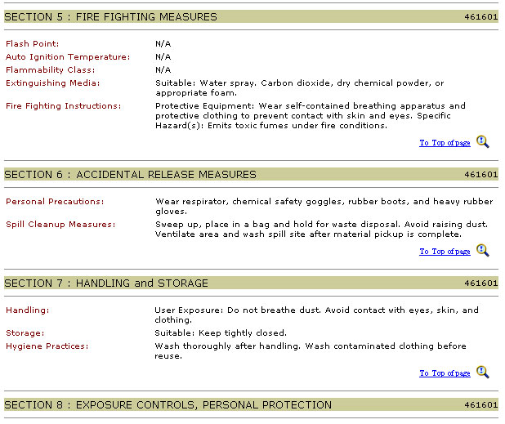

Slide 50
Types of Disinfecting Agents
Phenols
Quaternary Ammonium Compounds
Aldehydes
Ethylene oxide
Alcohols
Halogens
Biguanide

Slide 51
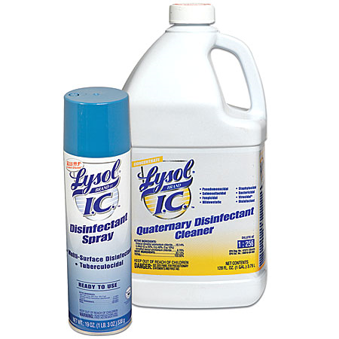
Phenols
  Work by destroying the selective permeability of cell membranes
  First antiseptics developed
  Effective against gram-positive and gram-negative bacteria, fungi, and some enveloped viruses
  Ineffective against non-enveloped viruses or bacterial spores
  Should not be used as antiseptics because:
    Can be very irritating to skin
    Can be absorbed systemically
    Linked to neurotoxicity

Slide 52

Quaternary ammonium compounds
  Work by concentrating at the cell membrane and dissolving lipids in the cell walls and membranes
  Effective against gram-positive and gram-negative bacteria, fungi, and enveloped viruses
  Not effective against spores; limited efficacy on fungi
  Third generation QACs work on enveloped viruses (Roccal D-plus – parvo)
  Usually not irritating to skin or corrosive to metal
  Organic debris, hard water, and soaps will inactivate QACs

Slide 53

Aldehydes
  Organic compounds that contain a functional group –CHO (carbon-hydrogen-oxygen)
  Work by affecting protein structure
  Rapid; kills fungi and bacteria within minutes and spores in about 3 hours.
  Effective against gram-positive and gram-negative bacteria, fungi, viruses, and bacterial spores
  Not inactivated by organic debris
  Toxic fumes; ventilation necessary

Slide 54


Ethylene oxide
  Works by destroying DNA and proteins
  Is a gas used for chemical sterilization
  Effective against gram-positive and gram-negative bacteria, fungi, viruses, and bacterial spores
  Very slow acting
  Explosive; potent carcinogen
  Can sterilize objects that cannot withstand heat

Slide 55

Alcohols
  Either 70% Ethyl alcohol or 50% or 70% Isopropyl alcohol in aqueous solutions
  Work by coagulating proteins and dissolving membrane lipids
  Effective against gram-positive and gram-negative bacteria, fungi, and enveloped viruses
  Ineffective on spores and nonenveloped viruses
  Non-irritating, non-toxic, inexpensive
  Must be applied in sufficient quantity, at proper concentration, and for an adequate time (several seconds to minutes) to be effective.
  Not recommended as antiseptic because it is painful and it denatures proteins
  Affected by dirt and organic debris

Slide 56


Halogens
  Work by interfering with proteins and enzymes of the microbe
  Chlorine kills bacteria, fungi, viruses, and spores
    Found in household bleach (Chlorox®)
    Routinely used in a 1:10 solution
    Easily inactivated by organic material
    Becomes unstable if exposed to light
  Iodine kills most classes of microbes if used at the proper concentration and exposure times
    Commonly used as topical antiseptics
    Iodophors – complexes of iodine and neutral polymer such as PVA
      Marketed as scrubs (have soap products added), solutions (diluted with water), tinctures (diluted with alcohol)
      Betadine®, Providine®

Slide 57



Biguanides
  Work by denaturing proteins
  Effective against gram-positive and gram-negative bacteria, fungi, and enveloped viruses
  Does not work on nonenveloped viruses and spores
    FeLV, FIP
  Fast acting
  Chlorhexidine (Nolvasan®, Hibiclens®)
    Commonly used as a surgical scrub and for cleaning wounds
    Can have residual activity of 24 hours
    One of the most commonly used disinfectants and antiseptics in vet med.
    Also shampoos, oral care, and ear cleaning solutions

Slide 58

Dental Treats impregnated with Chlorhexidine

Slide 59
Other agents
  Hydrogen peroxide damages proteins and is used to kill anaerobic bacteria; can cause tissue damage, so its use is limited
    Good for oral infections
  Soaps and detergents have limited bactericidal activity
    Main functions are mechanical removal of debris
    May contain ingredients effective against some bacteria
    Do not work on spores and have limited antiviral properties
Refer to Table 14-4 in your textbook for actions and uses of disinfecting agents

